Slide 1

SLIDE 1
Team Name: Magma
2. Members Name and Phone Numbers Aravind Harinarayanan (Leader)- 7356509761
Adithya Narayan- 90483 38928
Sonus Vareed- 90488 75664
3. Domain name: Open Innovation
4. Problem statement : Social Commerce

Slide 2
SLIDE 2
ABSTRACT
The solution provided by us is a first time innovative approach for the E-commerce industry which will aim to get the specified parameters for a given project before it actually suggest, hence making the suggested product have a more appropriate scope and scalability. We aim for max click through rates for the products we suggest. It is an easy Suggest with an accurate Product suggestion.

Slide 3
SLIDE 3
NOVELTY
• Collecting data based on which the model will be trained.
• Training the model to predict correctly and In the correct context.
• Achieving concurrency in forum where videos, images will also be shared.

Slide 4
SLIDE 4
TECHNOLOGY
STACK
• Backend – Flask
• Frontend – Bootstrap 5 with JQuery
• Cloud Service Providers - Heroku
• Database – Heroku Postgres ( or MongoDB

Slide 5
SLIDE 5
HARDWARE / SOFTWARE IMPLEMENTATION
Process Flow
• Users log in and chat
• Chat data is sent to the backend server where a model detects keywords indicating or depicting a particular product in discussion
• Search initiated one the probability for the keyword under discussion crosses a given threshold.
• From the retrieved list of products probably from amazon the best product is suggested along with the link to buy.

Slide 6
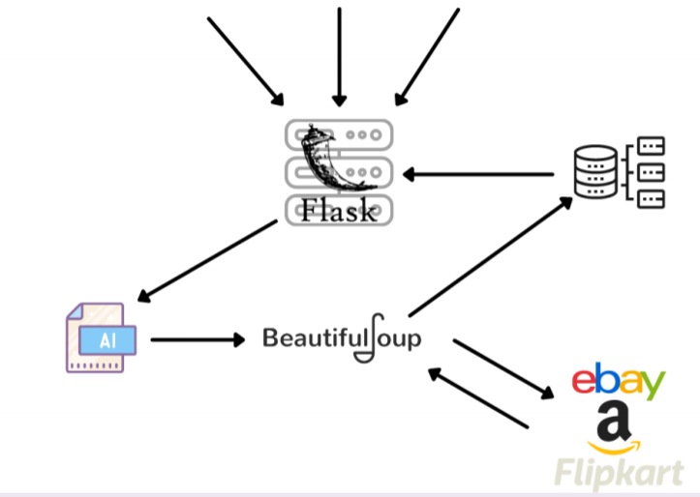
SLIDE 6
HARDWARE / SOFTWARE IMPLEMENTATION

Slide 7
SLIDE 7
BUSINESS SCOPE
Given the current situation product suggestions will be limited to 2 or 3 well known websites. Hence a mandatory future enhancement will involve the use of Kafka for distributed production and consumption of user messages and product suggestions.
Scaling is also a possible future enhancement with logins made easy using google auth. Shift to more reliable AWS servers with more workers so that we wont have a limit on the amount of people in the discussion forum simultaneously.
Constant monitoring for watching use of foul language etc is also a possible and important enhancement.

